Slide 1
FLTK Tutorial 3
CS4610, Sp13
By Rui Wang

Slide 2
Overview
Create menu, submenu and menu items.
Create a color chooser to change current drawing color.
Create a text display widget to display output coordinates.

Slide 3
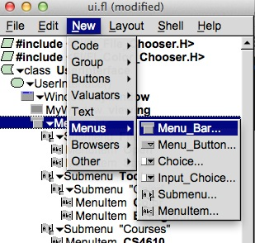
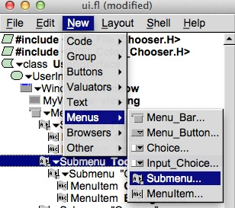
Menu, submenu & menu items
1. Create a menu bar under main window.
2. Create submenu as a child widget under menu bar.

Slide 4
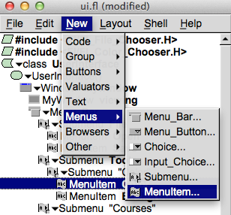

Menu, submenu & menu items
3. You can create multiple submenus under a submenu.
4. Create menu item under submenu to trigger event when click on it.(eg. Menu item “Drawing Color” under submenu “Color”)

Slide 5
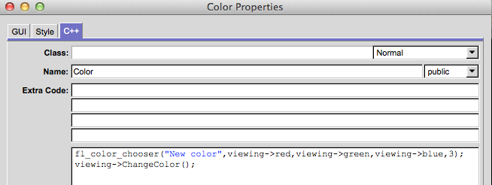
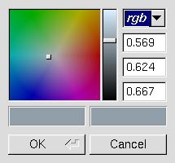
Color Chooser
The fl_color_chooser provides a standard rgb color chooser.
In this example a color chooser is created inside the callback function of the menu item “Color”.
“Red”, ”green”, “blue” are three predefined variable in viewing object. The color chooser will change the value of these three variables based on the color that the user selects.

Slide 6
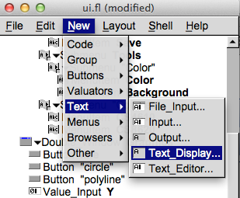
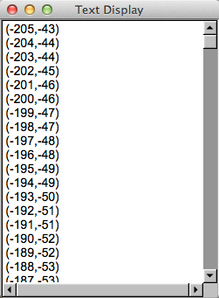
Text display
A text display widget is under New->Text. You can create a Window as a parent widget to hold it.

Slide 7
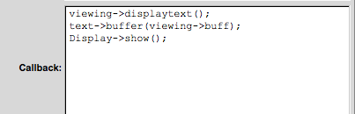
Print out coordinates in text display widget
Create a button with a callback function that pass coordinates’ values into text display widget.
Viewing->displaytext() is a member function in viewing that append coordinates’ values into a text buffer.
Text->buffer(viewing->buff) is a function that associate text buffer with display.
And Display->show() shows the window that contain the text display widget.

